Slide 1
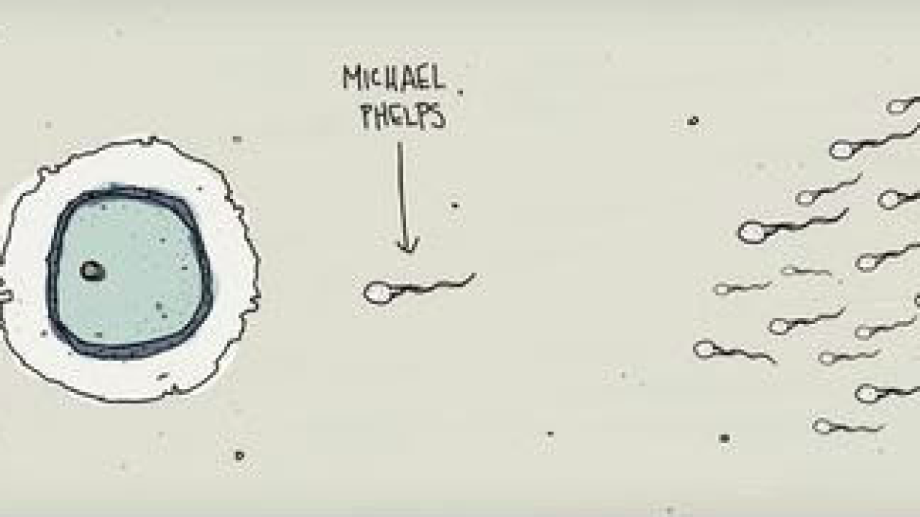
MEIOSIS

Slide 2
THE CELLS OF YOUR BODY
Somatic Cells are “body” cells and contain 46 chromosomes. This is called the “Diploid” number (the symbol is 2n)..
Gametes are the “sex” cells and contain only ½ the normal number of chromosomes…. called the “Haploid” number (the symbol is n)….. Sperm cells and ova are gametes.
How many chromosomes in a gamete?

Slide 3
Gametes
The Male Gamete is the Sperm and is produced in the male gonad the Testes.
The Female Gamete is the Ovum (ova) and is produced in the female gonad the Ovaries.

Slide 4
Meiosis is the process by which ”gametes” (sex cells) , with half the number of chromosomes, are produced.
During Meiosis diploid cells are reduced to haploid cells
Diploid (2n) → Haploid (n)
If Meiosis did not occur the chromosome number in each new generation would double…. The offspring would die.

Slide 5
Meiosis
Meiosis is two cell divisions
(called meiosis I and meiosis II)
with only one duplication of chromosomes.

Slide 6
Interphase I
Nucleus and nucleolus visible. Replication of DNA
Coiled mass of chromatid
nuclear membrane
cell membrane
nucleolus

Slide 7
Prophase I
Chromosomes condense
Homologous (2 set of 1 chromosome) come together
crossing over occurs (swapping of chromatid)

Slide 8
Homologous Chromosomes
chromatids
site of crossing over
variation

Slide 9
Prophase I
spindle fiber
centrioles

Slide 10
Metaphase I
Pairs align on the metaphase plate.
metaphase plate

Slide 11
Anaphase I
Homologous chromosomes separate and move towards the poles.
Sister chromatids remain attached at their centromeres.

Slide 12
Anaphase I

Slide 13
Telophase I

Slide 14
Meiosis II
No interphase II
(or very short - no more DNA replication)

Slide 15
Prophase II
same as prophase in mitosis

Slide 16
Metaphase II
same as metaphase in mitosis
metaphase plate
metaphase plate

Slide 17
Anaphase II
same as anaphase in mitosis
sister chromatids separate

Slide 18
Telophase II
Same as telophase in mitosis.
Nuclei form.
Cytokinesis occurs.

Slide 19
Telophase II

